Slide 1
Hostel Master Form
“Using HTML, CSS, JavaScript, jQuery, and Bootstrap”

Slide 2
Introduction
The Student Details Form is built using HTML to collect Institution Name, Hostel Name ,Warden contact, and address information etc… in a structured way. It uses form elements like input fields, dropdowns, and checkboxes with validation to ensure accurate data entry. Combined with CSS and JavaScript, the form becomes interactive and user-friendly.

Slide 3
HTML
HTML (HyperText Markup Language) is the backbone of web forms.
Provides structure and elements for user data collection.

Slide 4
Purpose of the Form
Collect students details systematically.
Includes Institution Name , Wardencontact, and address Information,Hostel name and Hostel Contact Number
Provides validation and interactive features.
Improves user experience with dropdowns, file upload.

Slide 5
Input Types in the Form
List of Inputs in the Form
Institution Name (text, required)
Hostel Name (text, required)
Warden Name (text, required)
Hostel Contact Number (text, required, must be a valid 10-digit mobile number)
Full Address (textarea, required)
Total Students Capacity (number, min 1, required)
Number of Floors (number, min 1, required)

Slide 6
Room Type (select box: Single, Double, Triple; required)
Fee Type (select box: Monthly, Quarterly, Annually; required)
Fee Amount (INR) (number, min 0, required)
Security Deposit (INR) (number, min 0, optional)
Fee Includes (checkbox group: Electricity Bill, Water Bill, Maintenance; optional)
Curfew Time (time, optional)
Hostel Facilities (checkbox group: Wi-Fi, Water, Food, Laundry, Security, Parking, Gym; optional)
Guest Policy (select: Allowed, Not Allowed; required, defaults to Allowed)
Status (select: Active, Inactive; required)

Slide 7
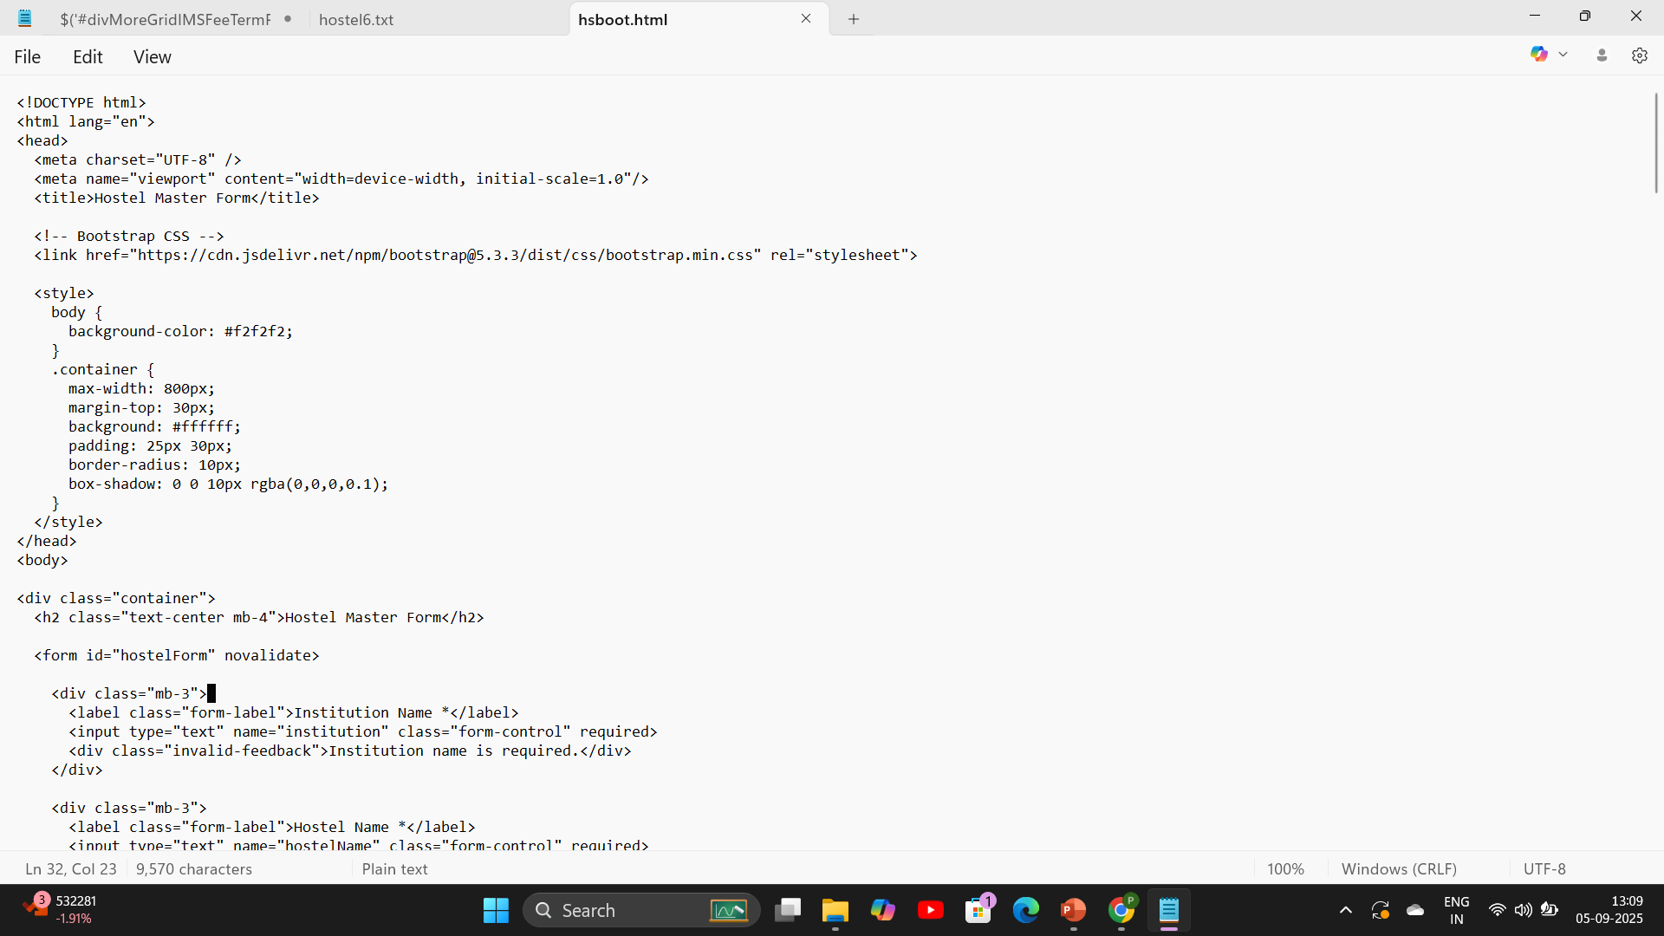
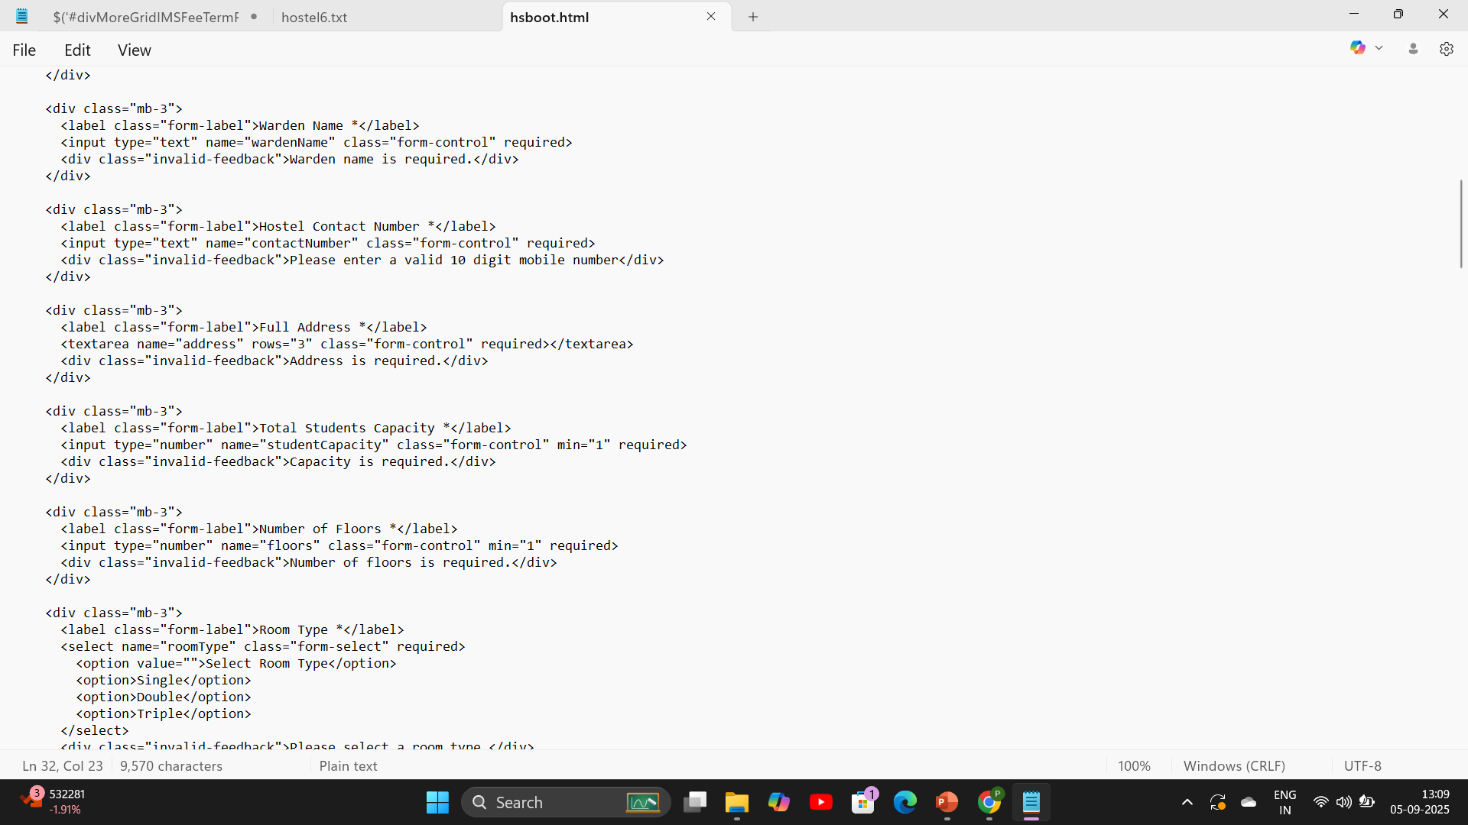
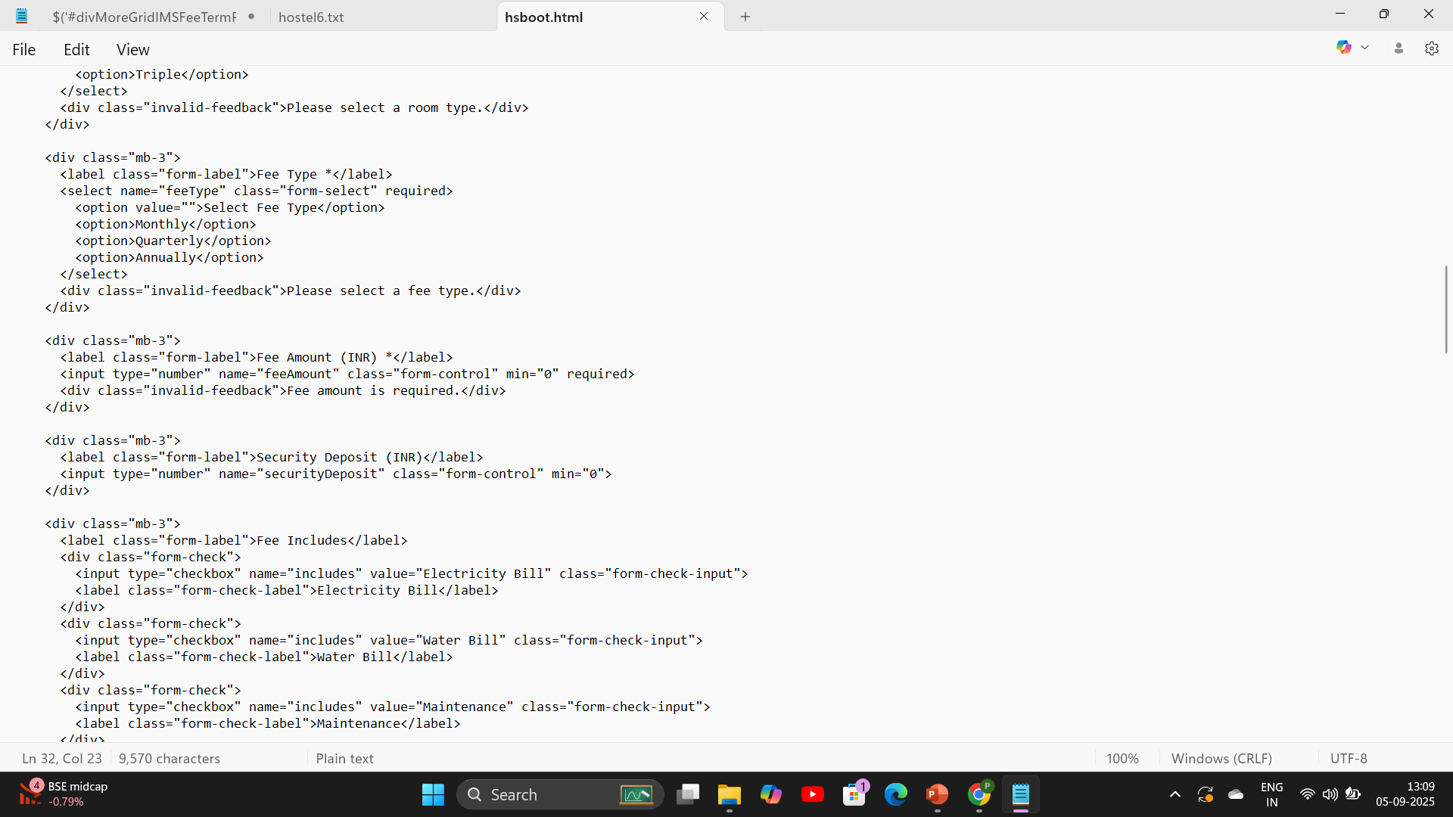
Preview code

Slide 8
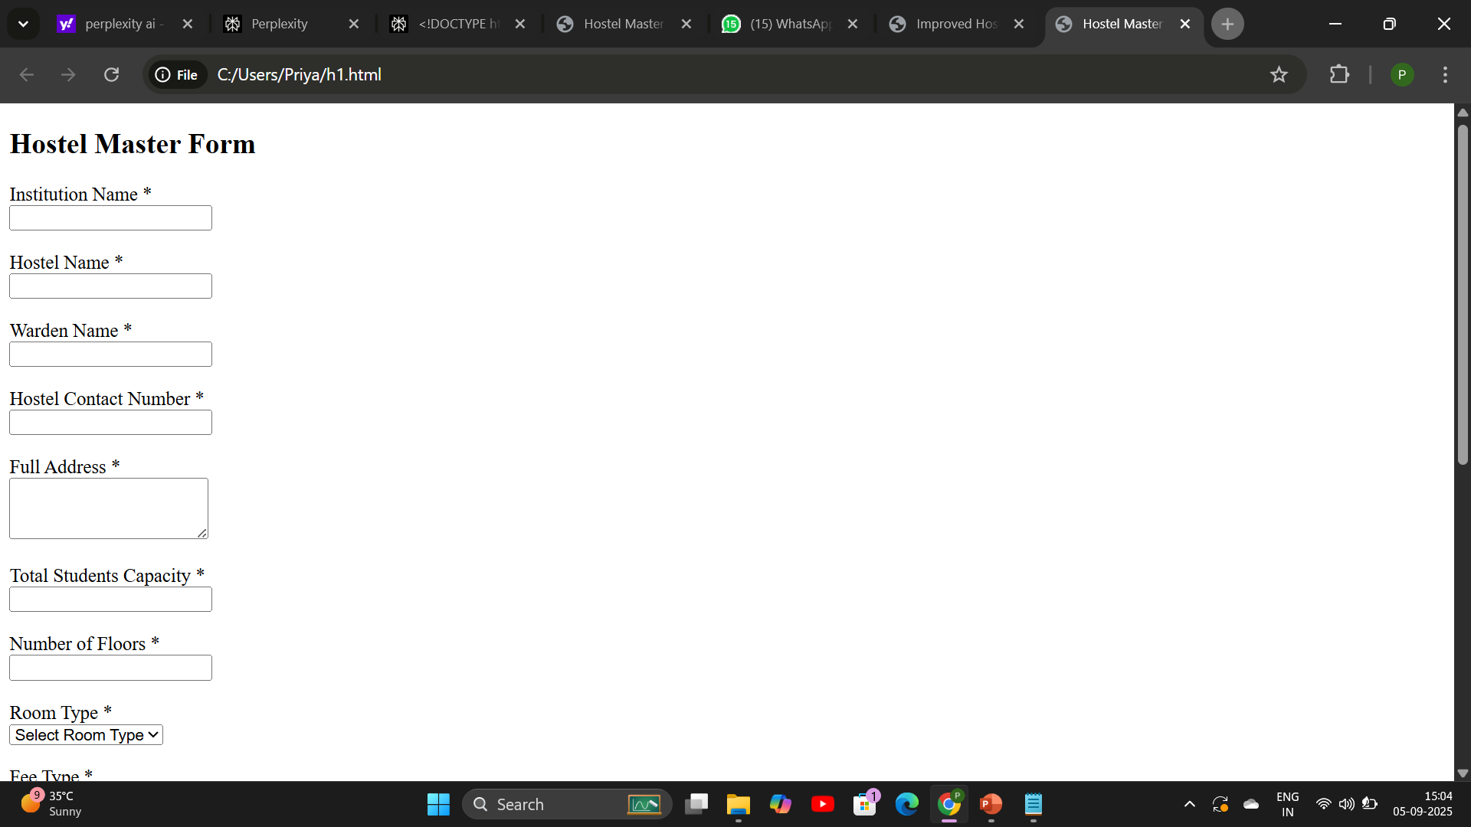
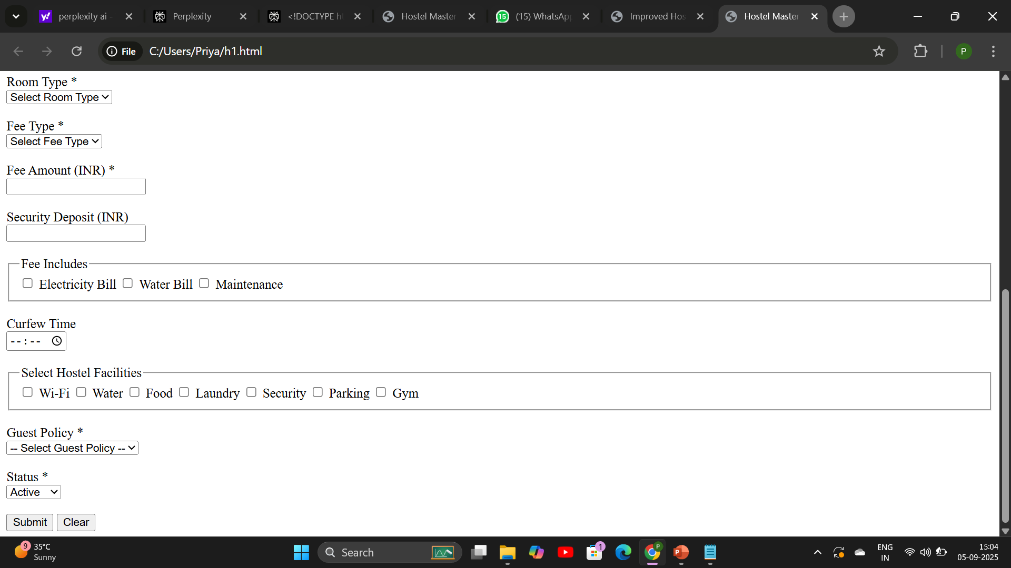
Preview form

Slide 9
CSS
CSS (Cascading Style Sheets) is used to design and style HTML forms.
It controls the layout, colors, fonts, spacing, and responsiveness.
Enhances user experience and readability.

Slide 10
How css used in the Form
Background Colors
Page Background:
Property: background-color: #f2f2f2;
Form Container Background:
Property: background-color: #e6f2ff;
Used for the .container class, which wraps your form.

Slide 11
Brand/Highlight Color
Button Brand Color:
Property: background-color: #4CAF50;
Used for the .submit button, giving it a typical brand accent look (green type commonly used for "submit" actions).

Slide 12
Buttons Styling
Primary Button (Submit):
Orange (#FF7A30), changes to blue (#485A82) on hover.
Secondary Button (Clear):
Blue (#485A82), changes to orange on hover.
Smooth hover transitions for better interactivity.

Slide 13
Overall Impact of CSS
This CSS:
Sets the page font and background color.
Styles the form container with padding, background, shadow, and rounded corners.
Defines spacing between form groups and labels.

Slide 14
Makes inputs, selects, and textareas full width with padding and
Adds red border color for validation errors.
Aligns checkbox and radio labels with spacing.

Slide 15
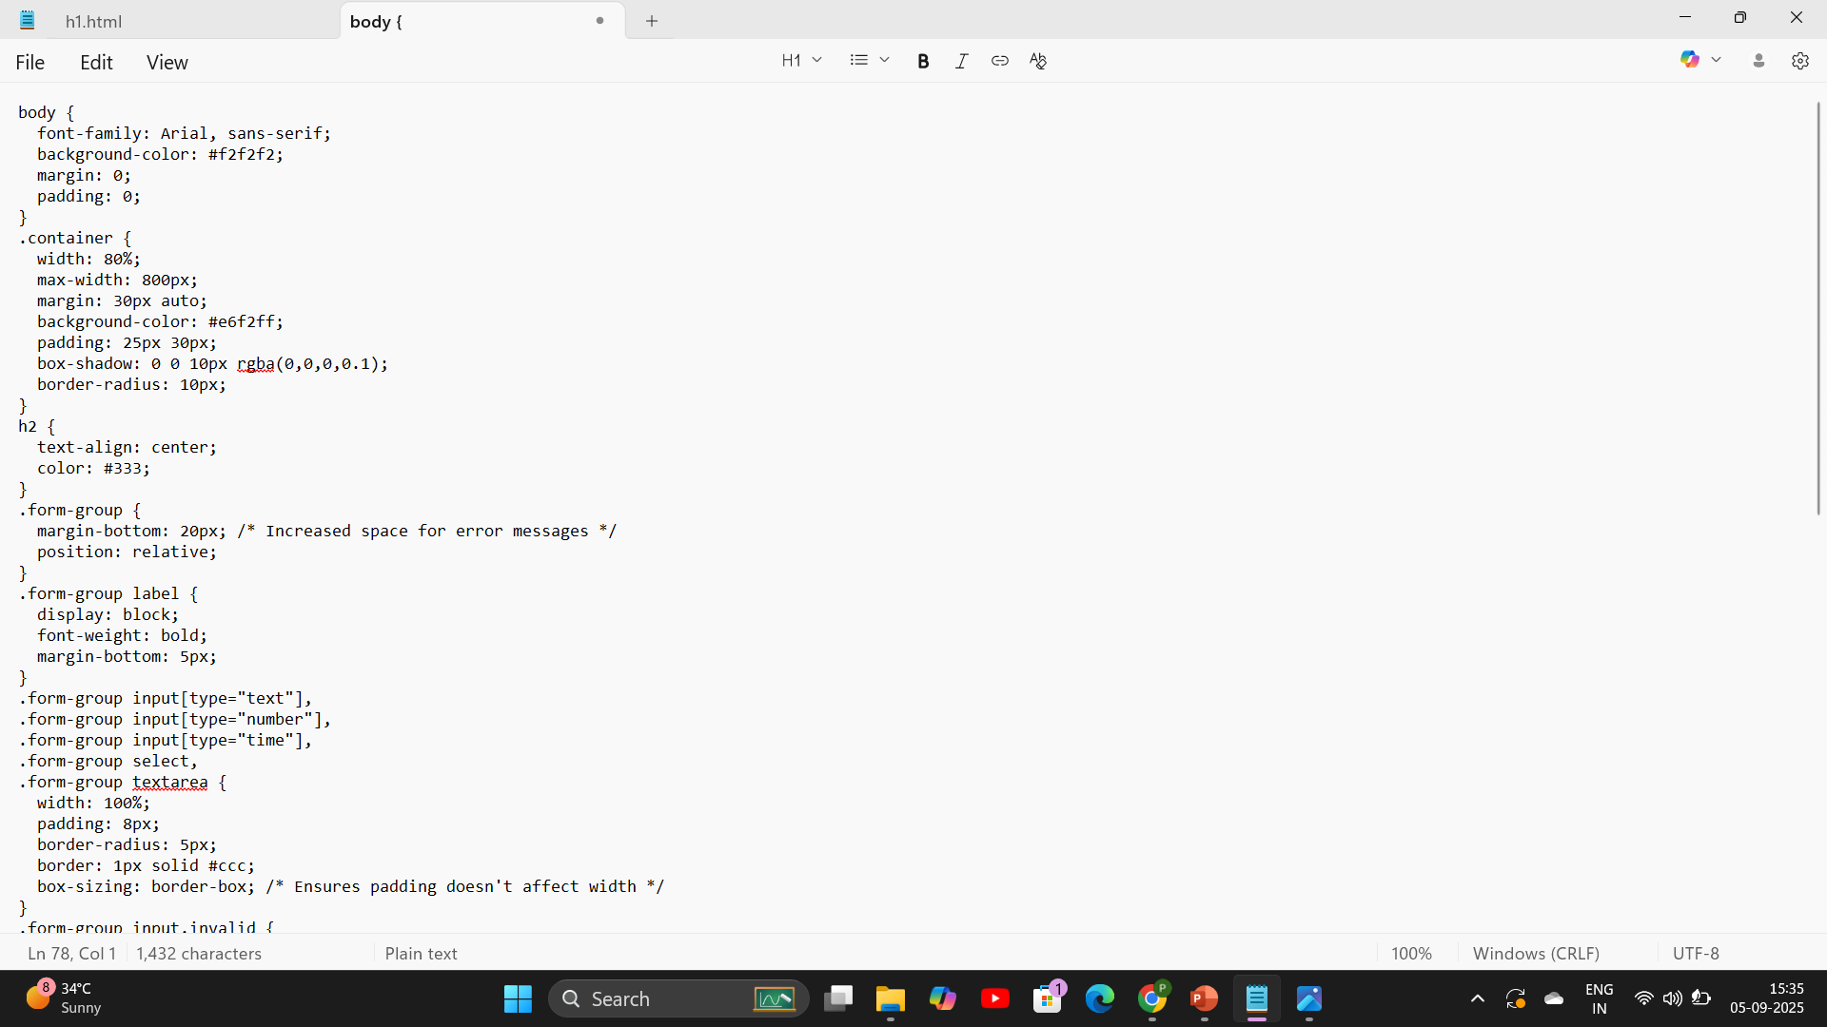
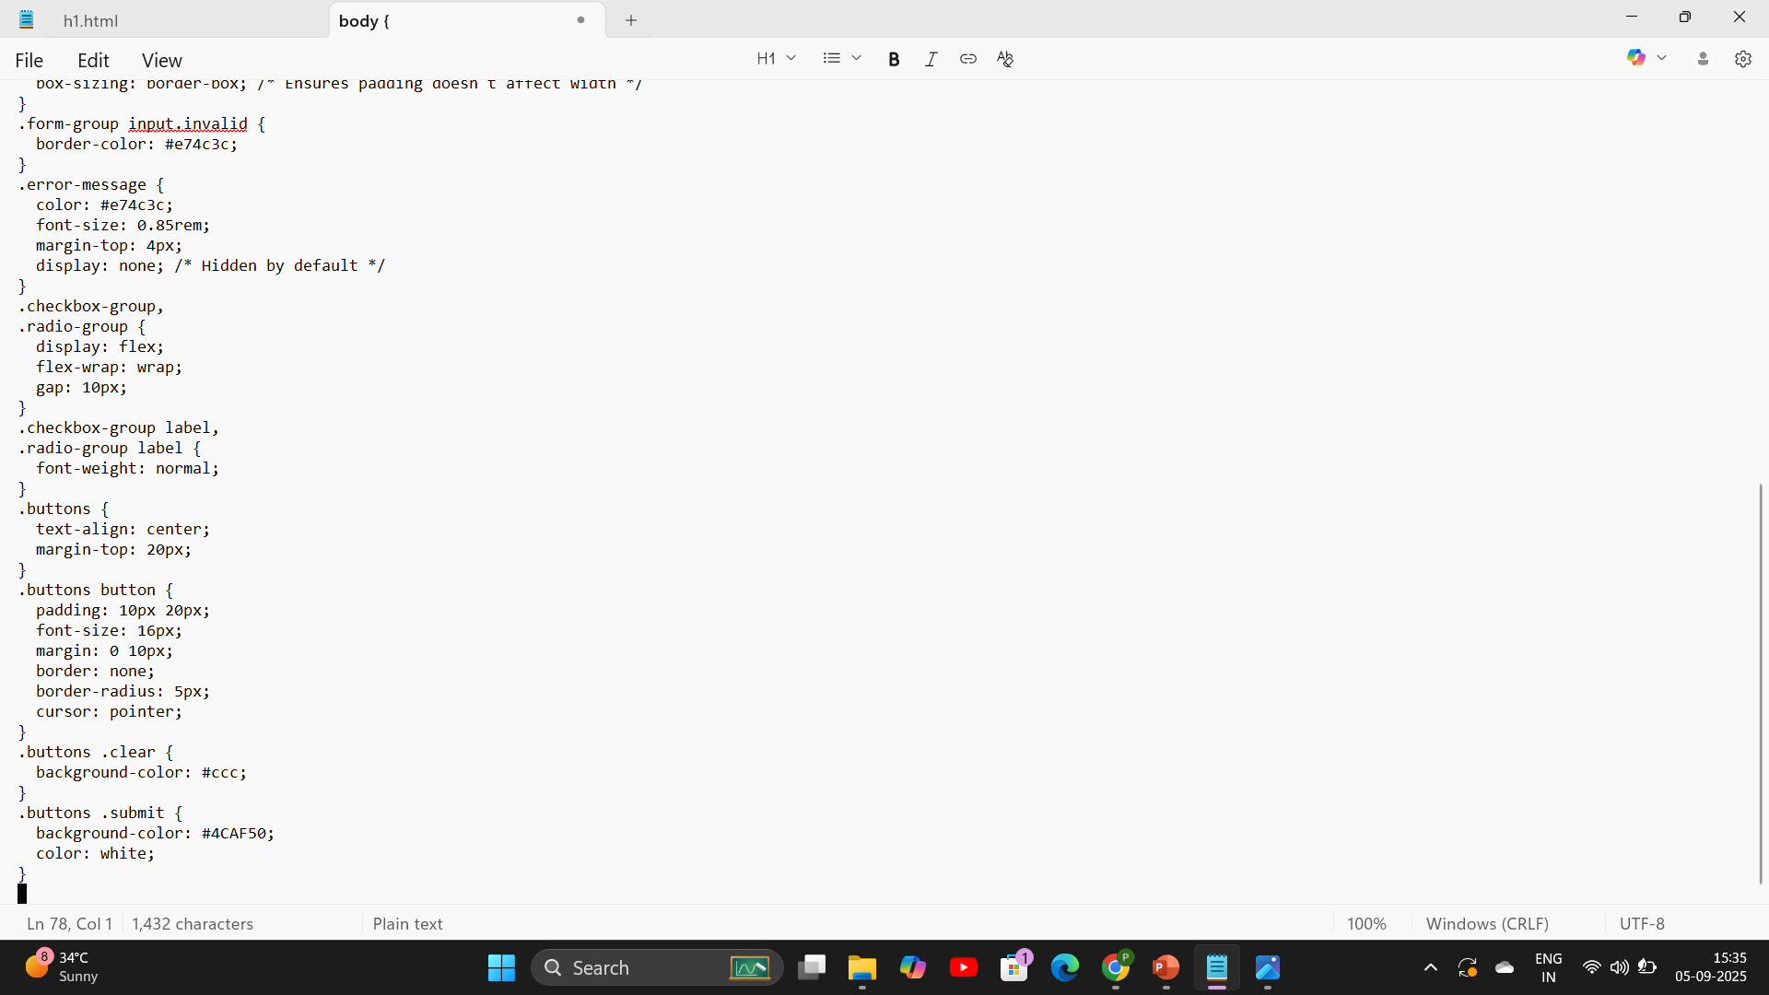
Preview Code

Slide 16
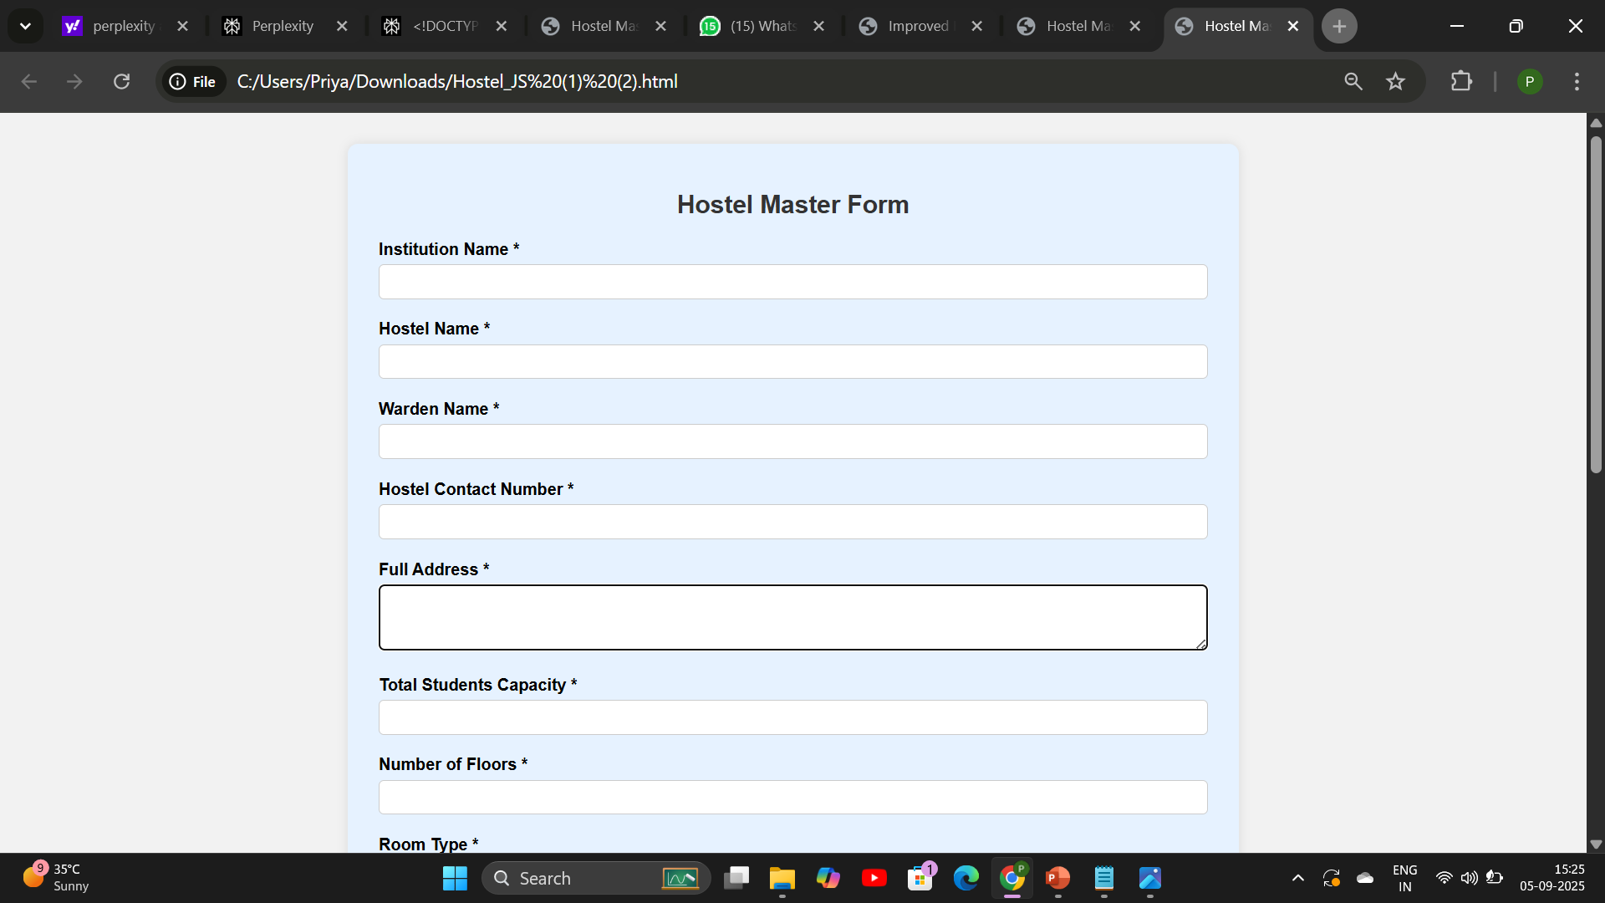
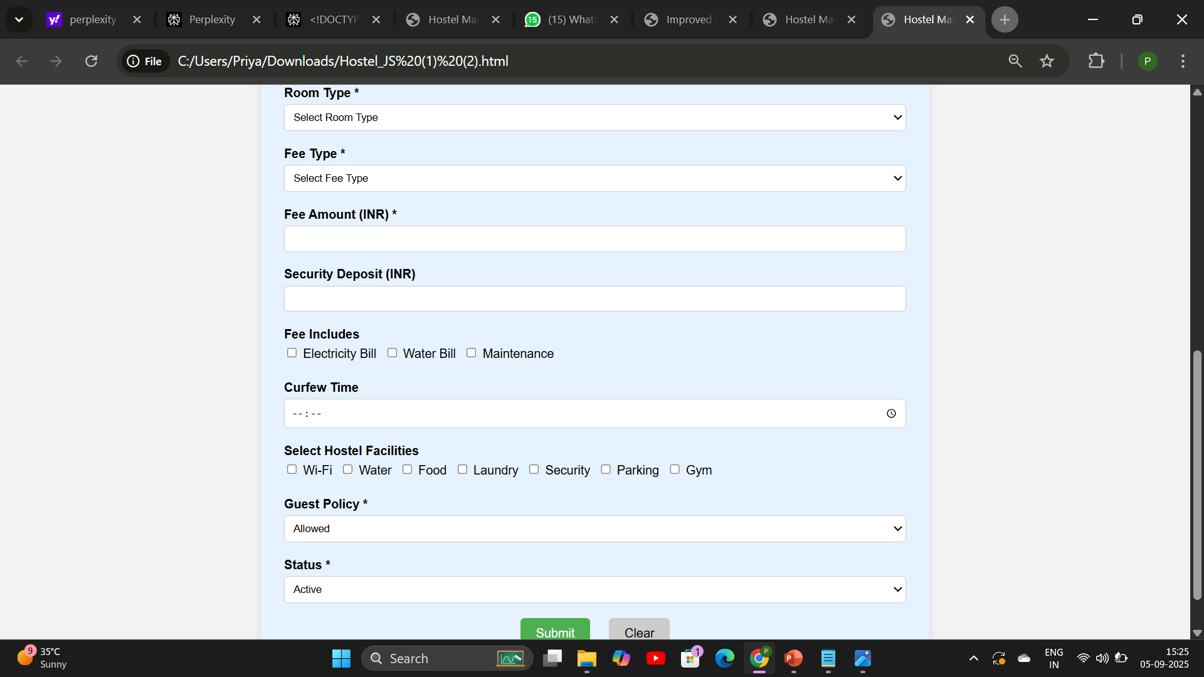
Adding CSS with HTML

Slide 17
Java script
JavaScript is a versatile, client-side scripting language that runs in the browser.
It enables creating interactive elements like buttons, forms, sliders, and pop-ups.
Form validation: Checking input correctness before submitting to the server.
Dynamic content updates: Changing webpage content dynamically wit

Slide 18
JavaScript In Form
Validates if required fields like Institution Name, Hostel Name, Warden Name, Contact Number, etc., are not empty.
Checks that the Hostel Contact Number is a valid 10-digit number.
Shows error messages next to inputs if the validation fails by displaying and styling error message elements.

Slide 19
Prevents form submission when validation errors exist to avoid invalid data being submitted.
Clears error messages and resets validation states when the user corrects the input or resets the form.

Slide 20
Validation In Hostel Master Form
Institution Name:
Required field
Must contain only letters and spaces
Regex: ^[A-Za-z\s]+$

Slide 21
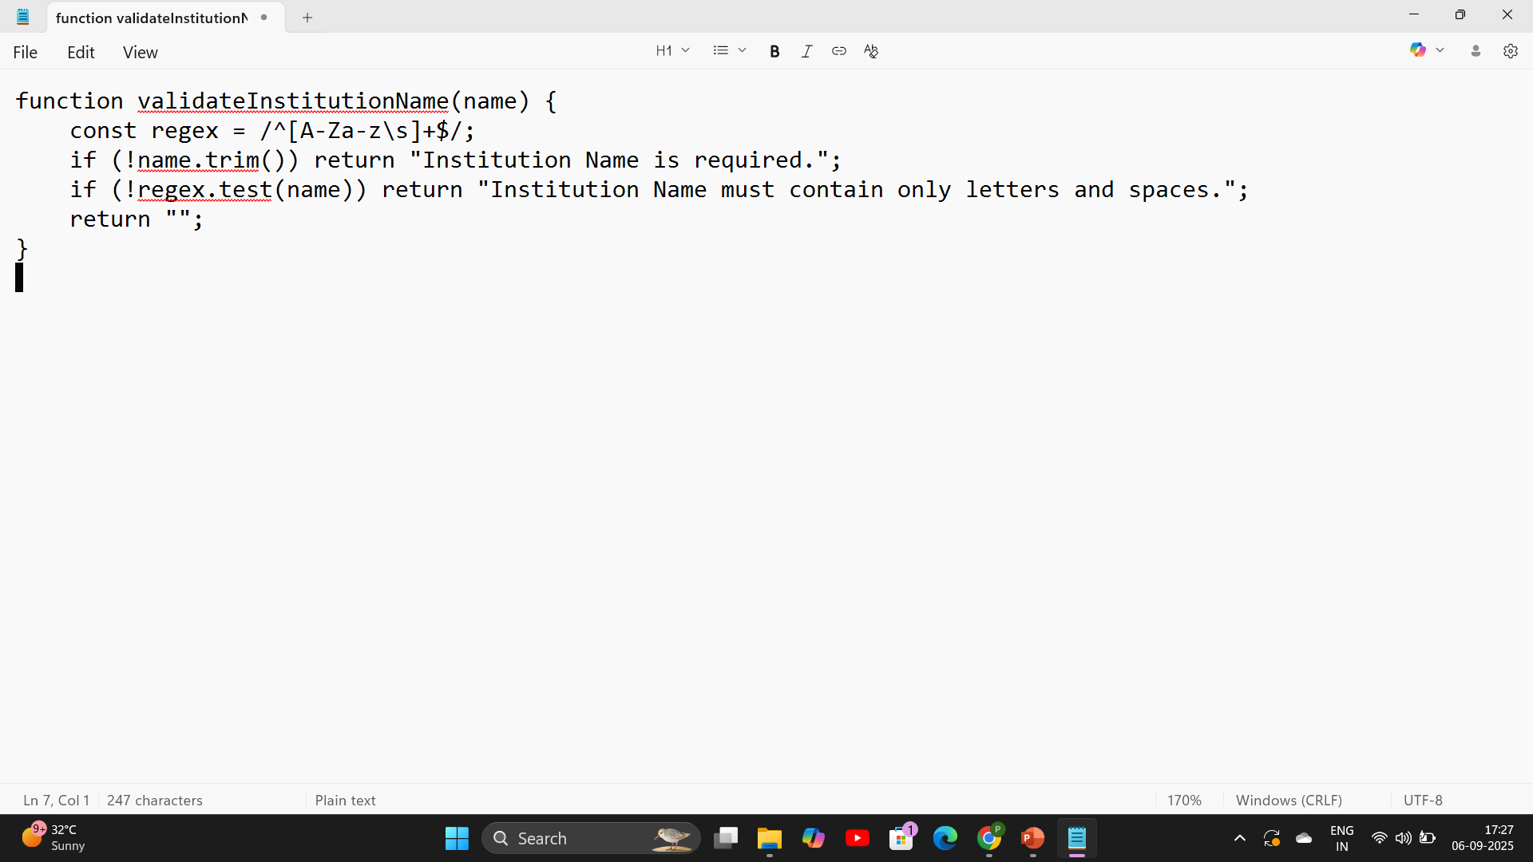
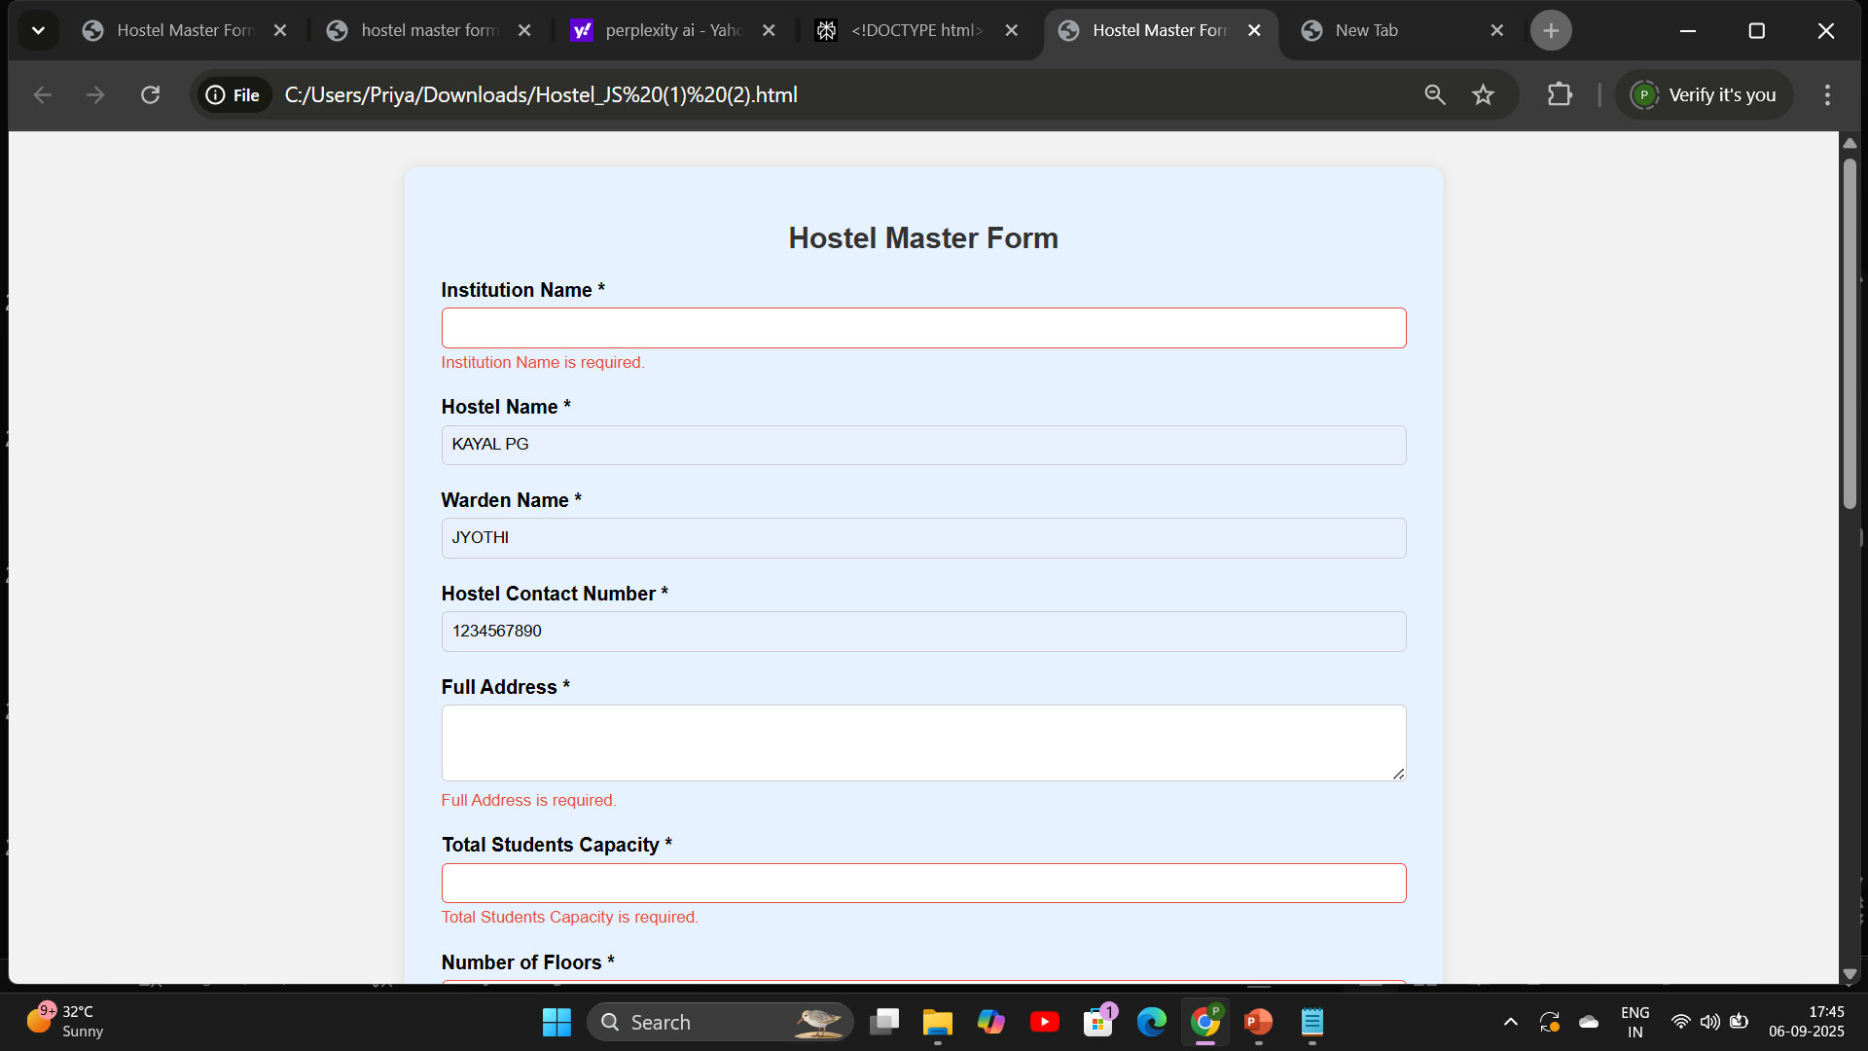
Adding Function Before and After

Slide 22
Hostel Name
Required field
Must contain only letters and spaces
Regex: ^[A-Za-z\s]+$

Slide 23
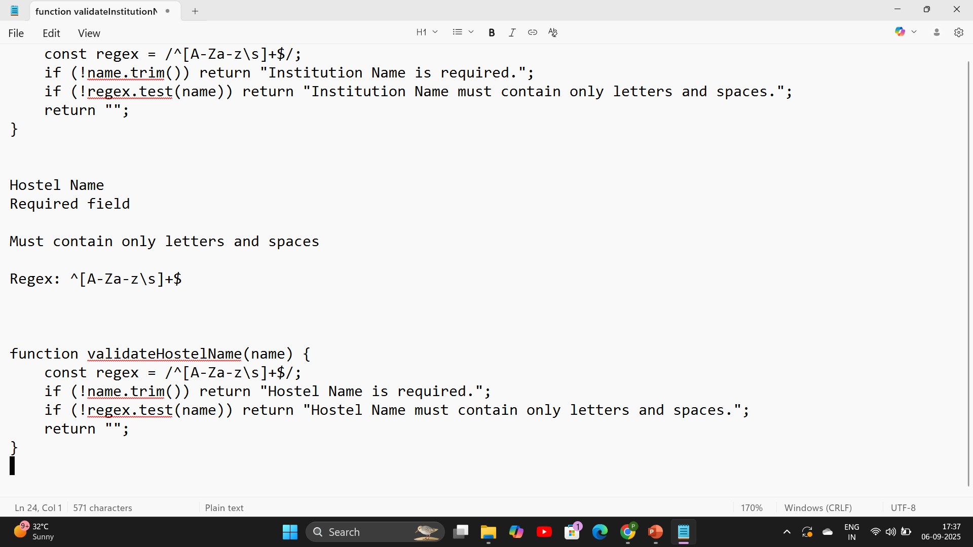
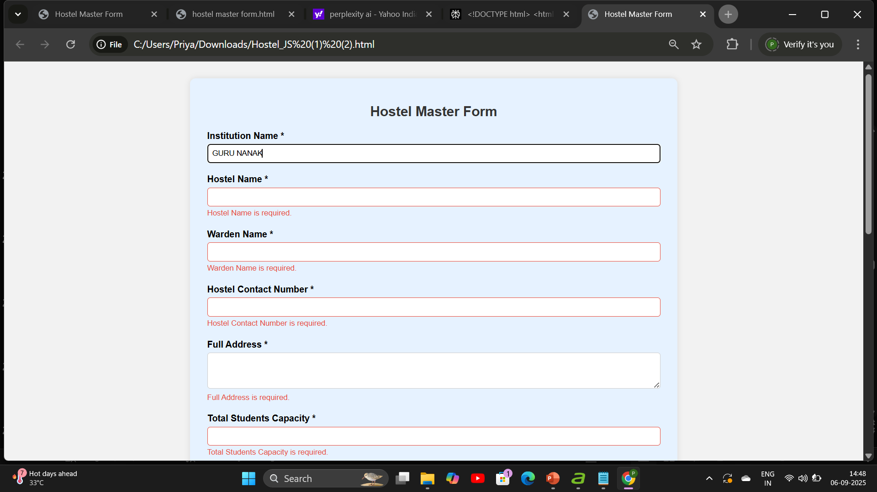
Adding function before and after

Slide 24
Warden Name
Required field
Must contain only letters and spaces
Regex: ^[A-Za-z\s]+$

Slide 25
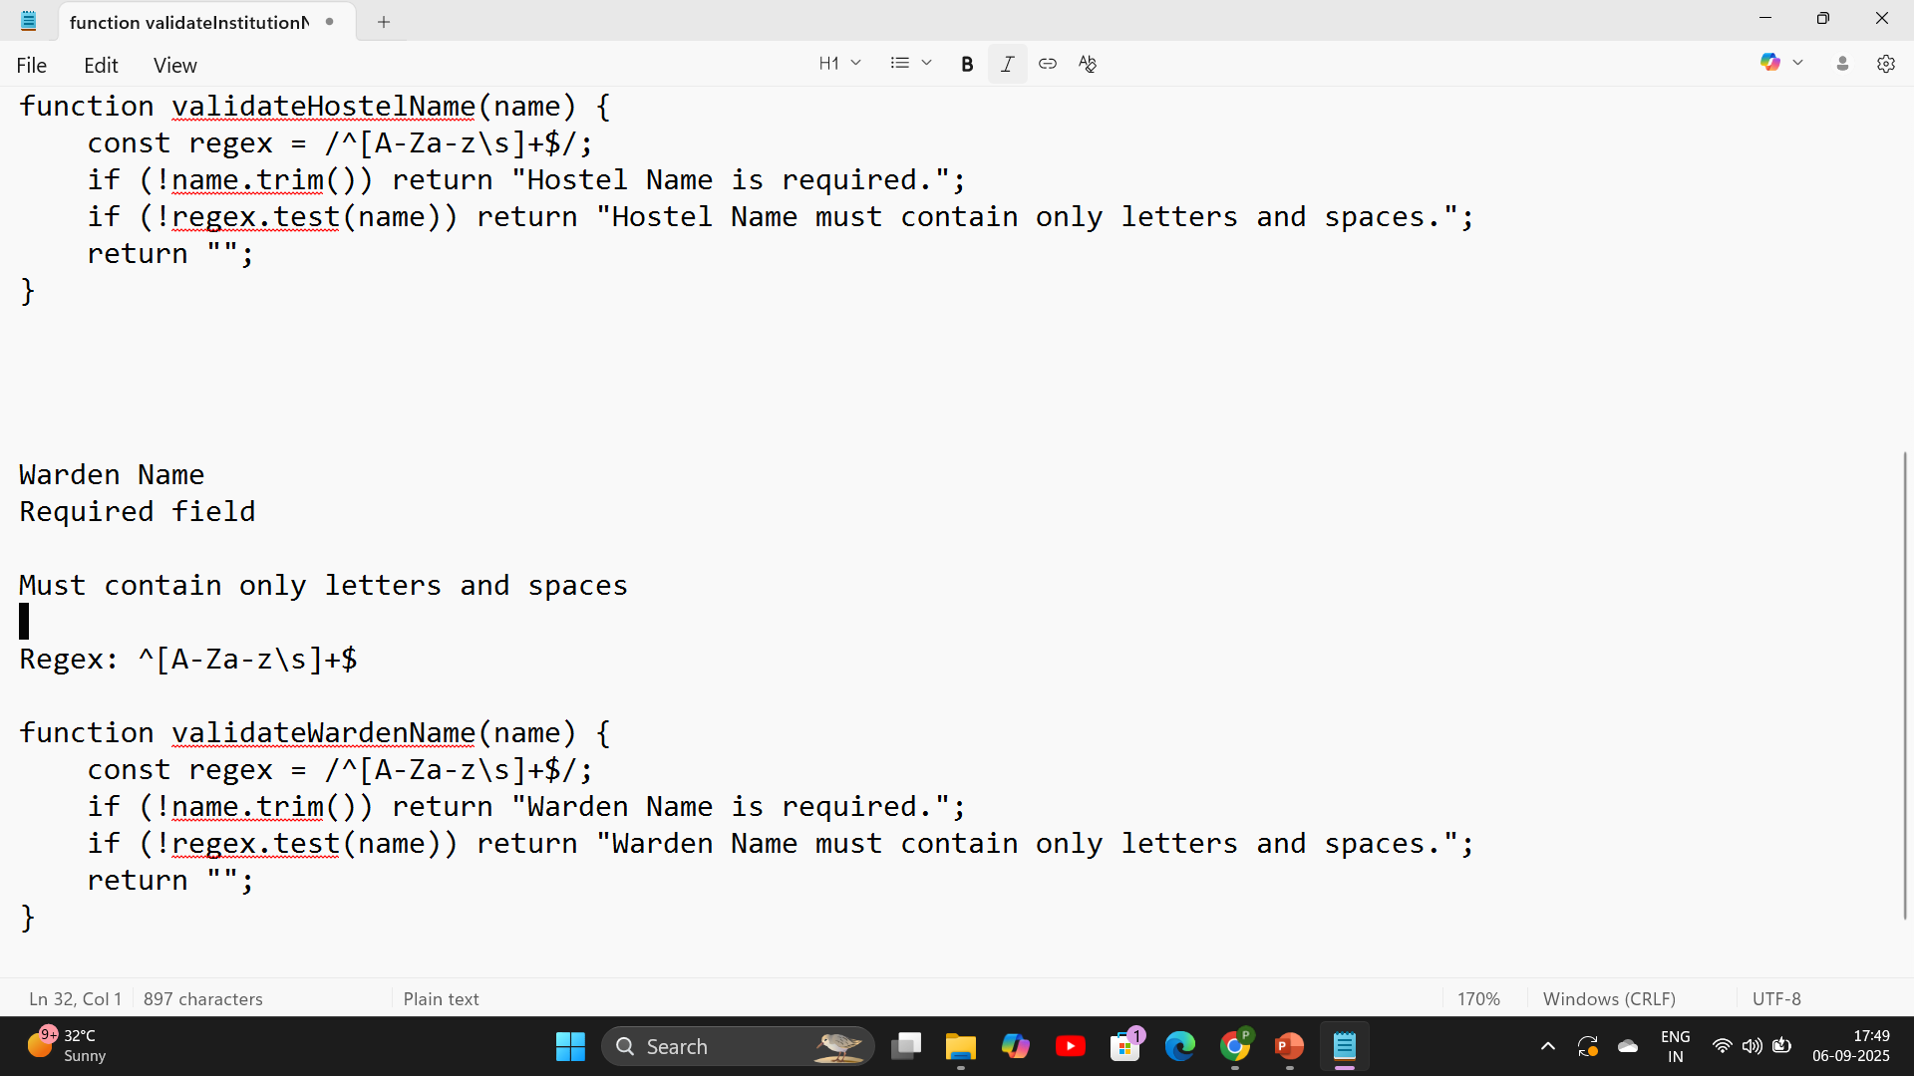
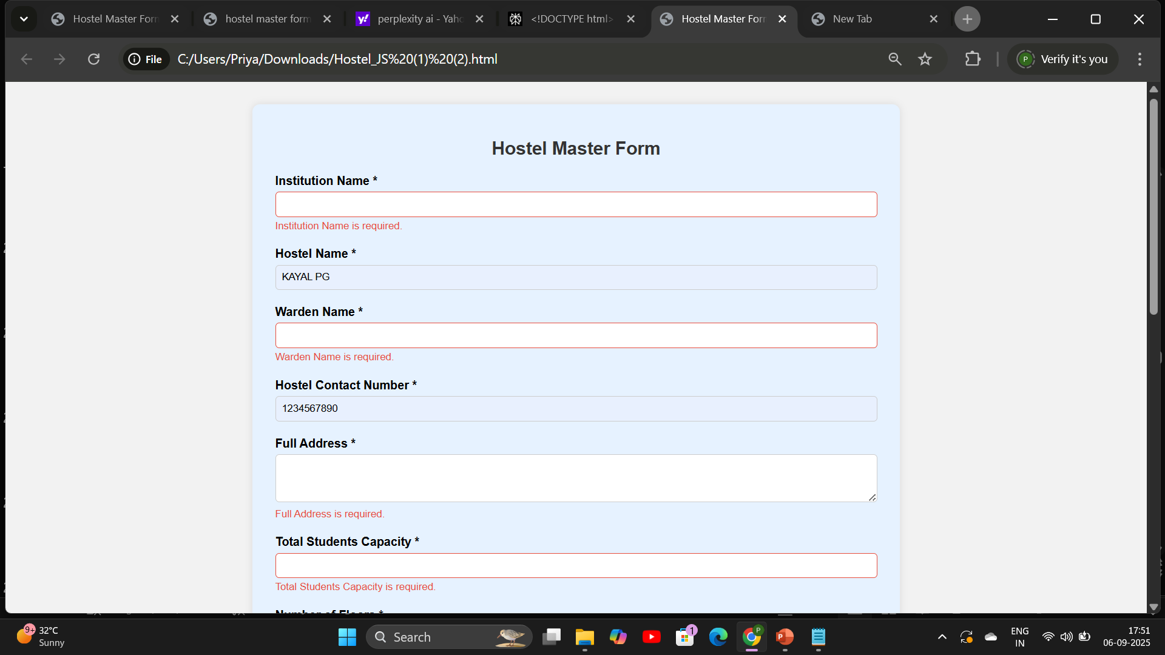
addind function before and after

Slide 26
Hostel Contact Number
Required field
Must be exactly 10 digits
Only numbers allowed
Regex: ^[0-9]{10}$

Slide 27
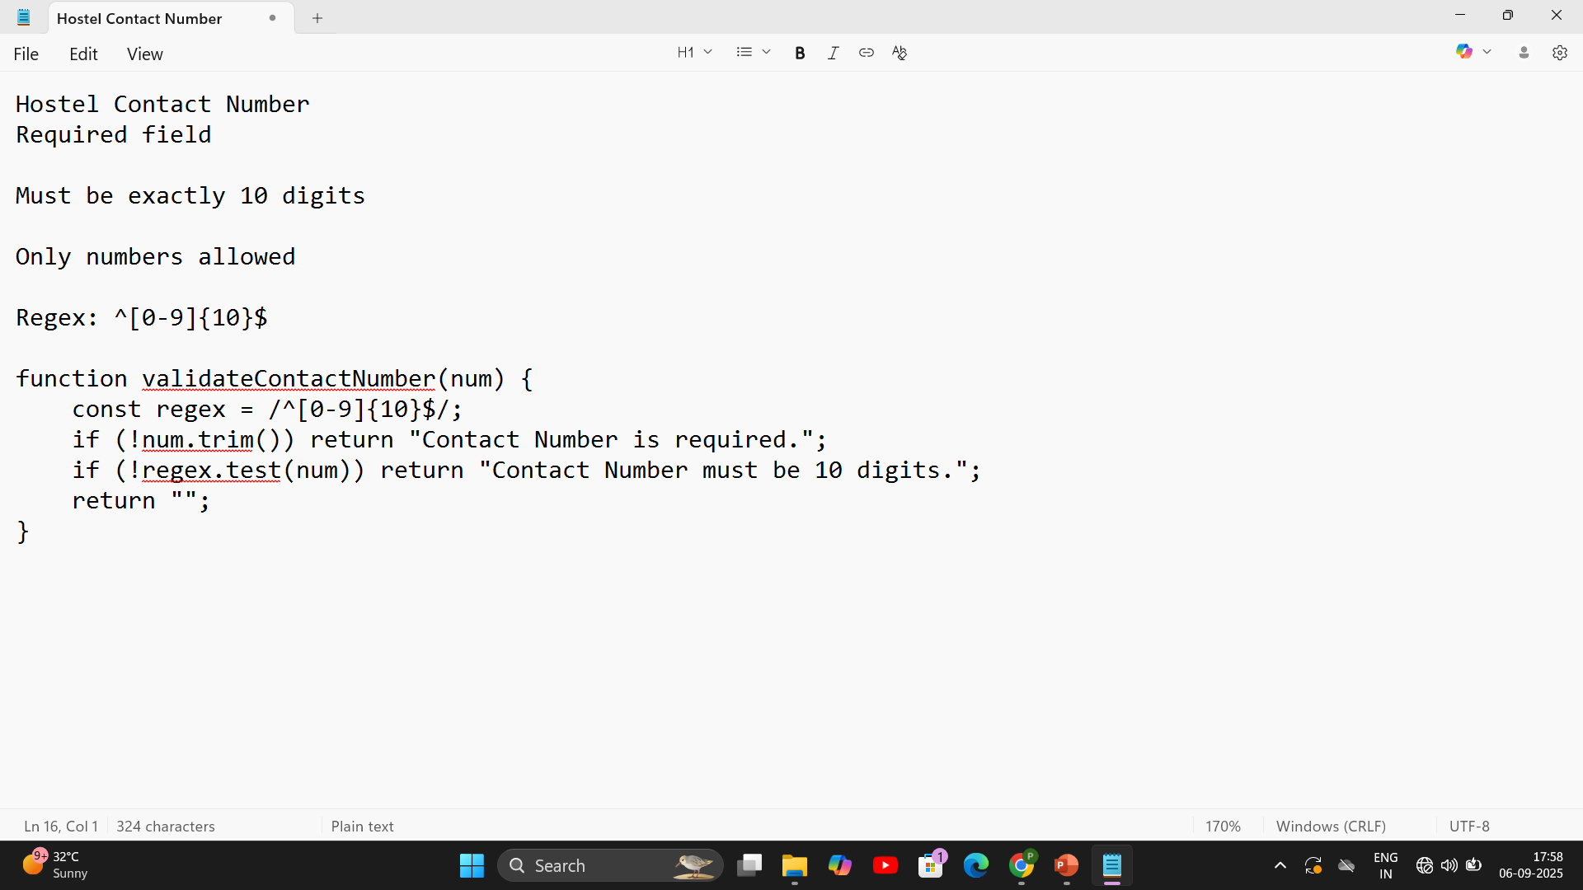
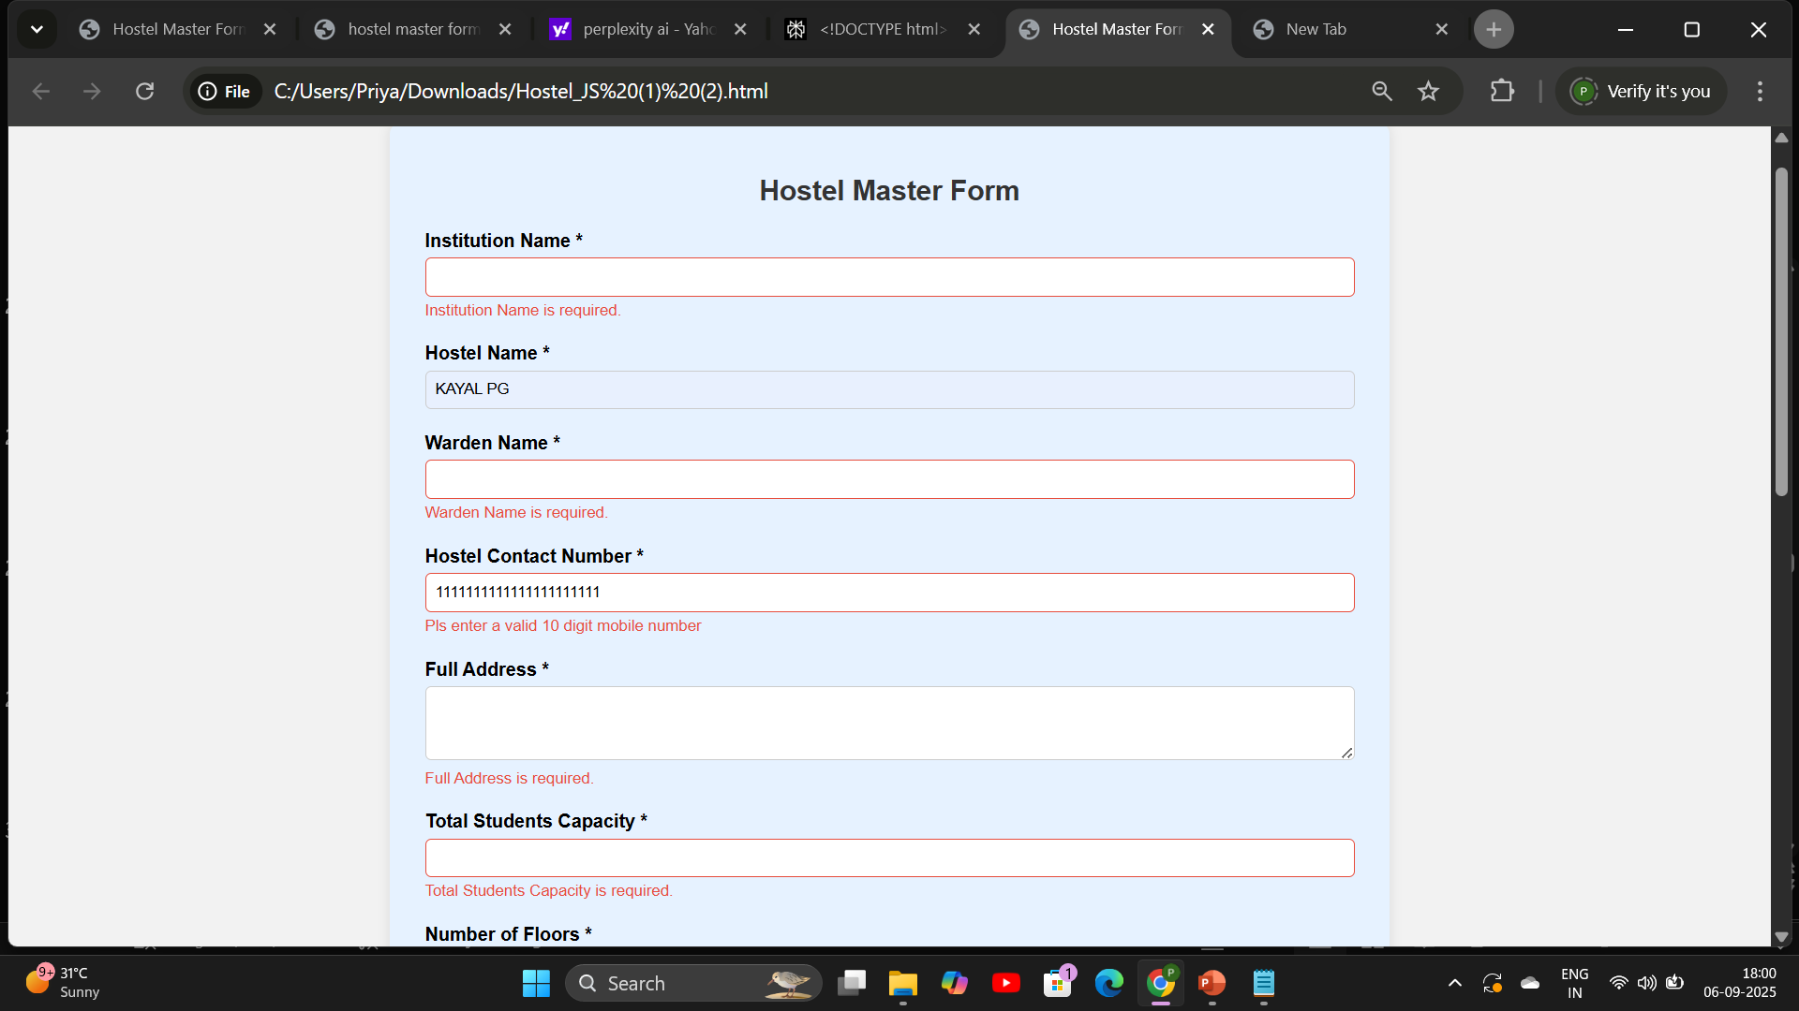
adding function before and after

Slide 28
Full Address
Required field
Can contain letters, numbers, spaces, commas, dots, and hyphens
Regex: ^[A-Za-z0-9\s,.-]+$

Slide 29
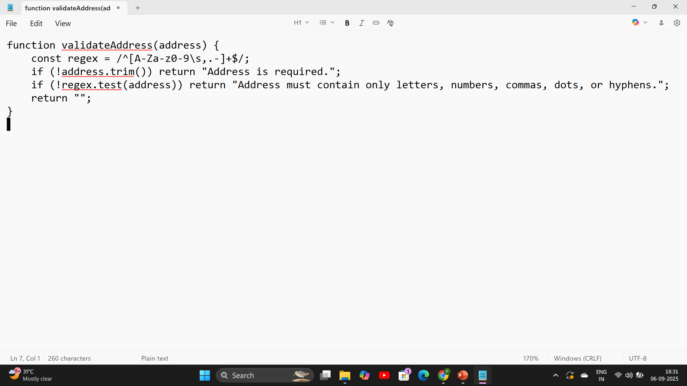
adding function before and after

Slide 30
Student Capacity
Required field
Must be a number greater than or equal to 1

Slide 31
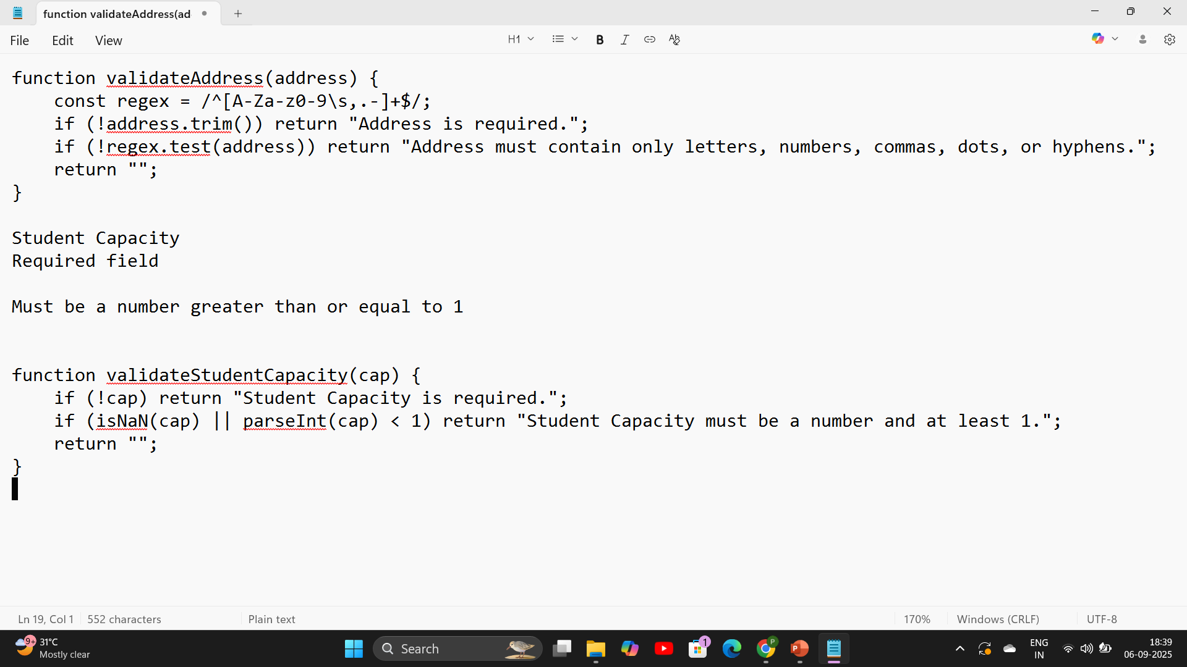
Addind function before and after

Slide 32
Number of Floors
Required field
Must be a number greater than or equal to 1

Slide 33
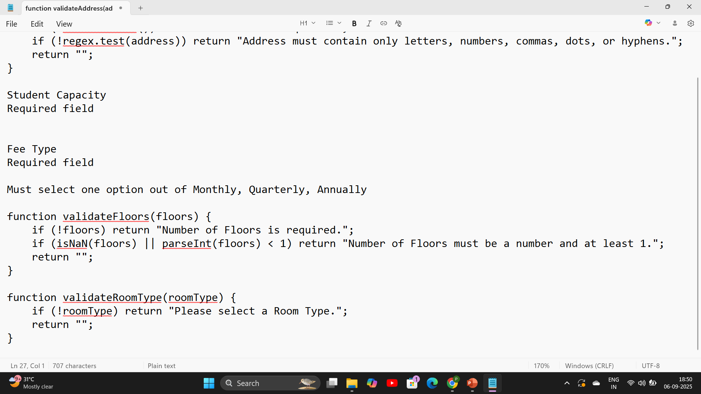
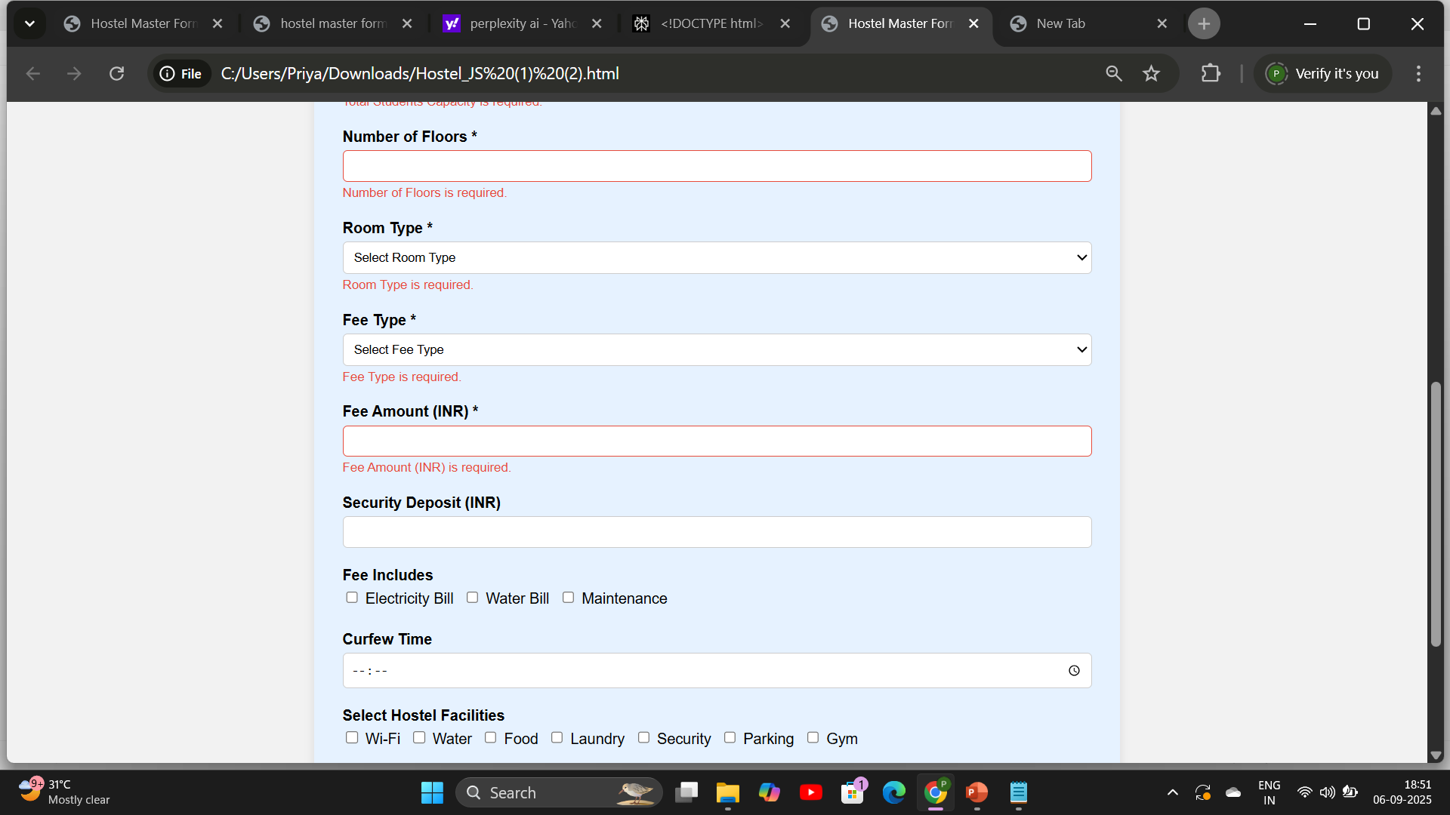

Slide 34
Room Type
Required field
Must select one option out of Single, Double, Triple

Slide 35
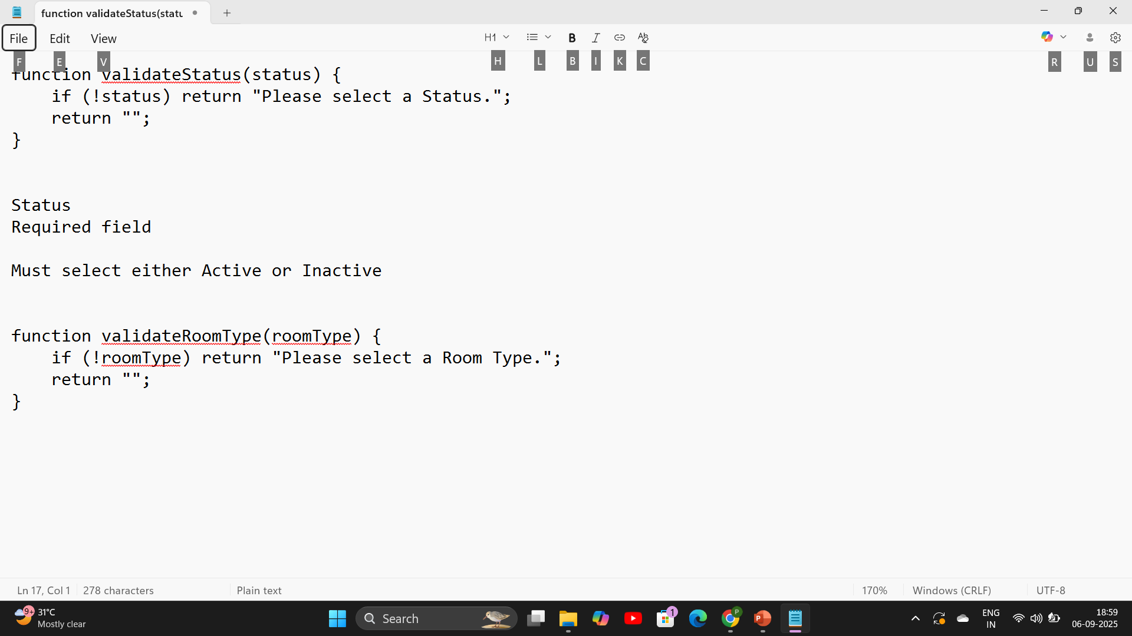

Slide 36
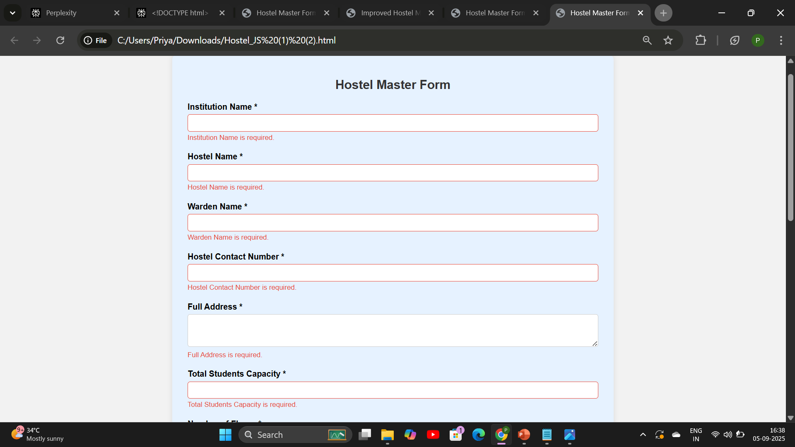
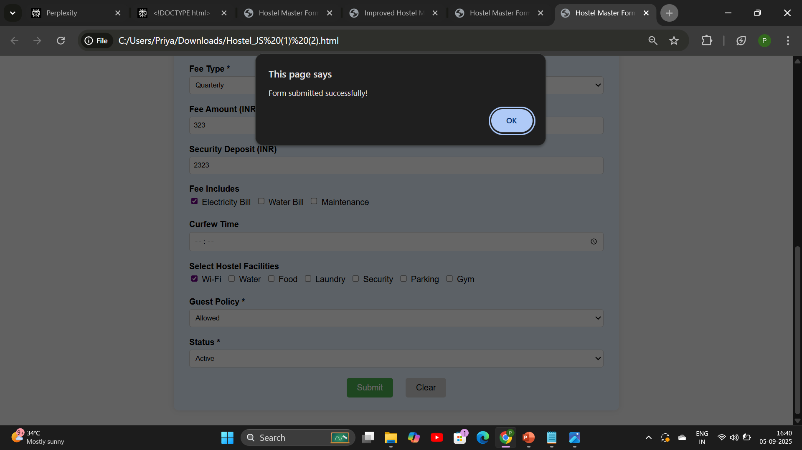
Before and After Adding Function

Slide 37
jQuery
A lightweight JavaScript library
Simplifies DOM manipulation and event handling
Cross-browser compatibility built-in

Slide 38
jQuery used for:
Validate required fields.
Check specific rules (like 10-digit contact number).
Show/hide error messages.
Restrict numeric inputs.
Manage form submit and reset behavior.

Slide 39
Extra Features
Checking required fields to ensure that important inputs are not left empty.
Filtering inputs so that fields like Student Capacity, Floors, Fee Amount, Security Deposit, and Contact Number accept only numeric values.
Showing clear error messages close to the relevant input whenever validation fails.

Slide 40
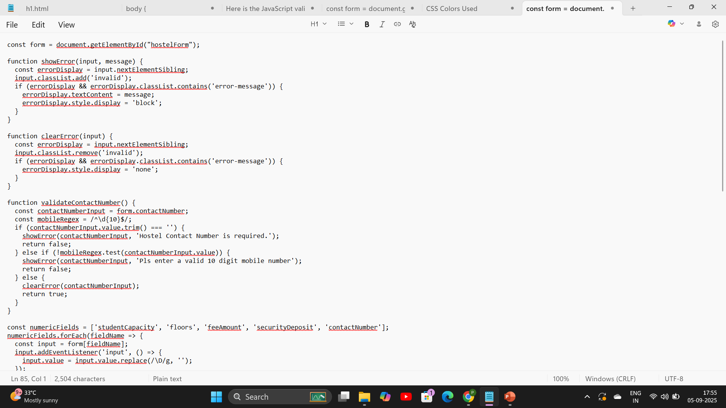
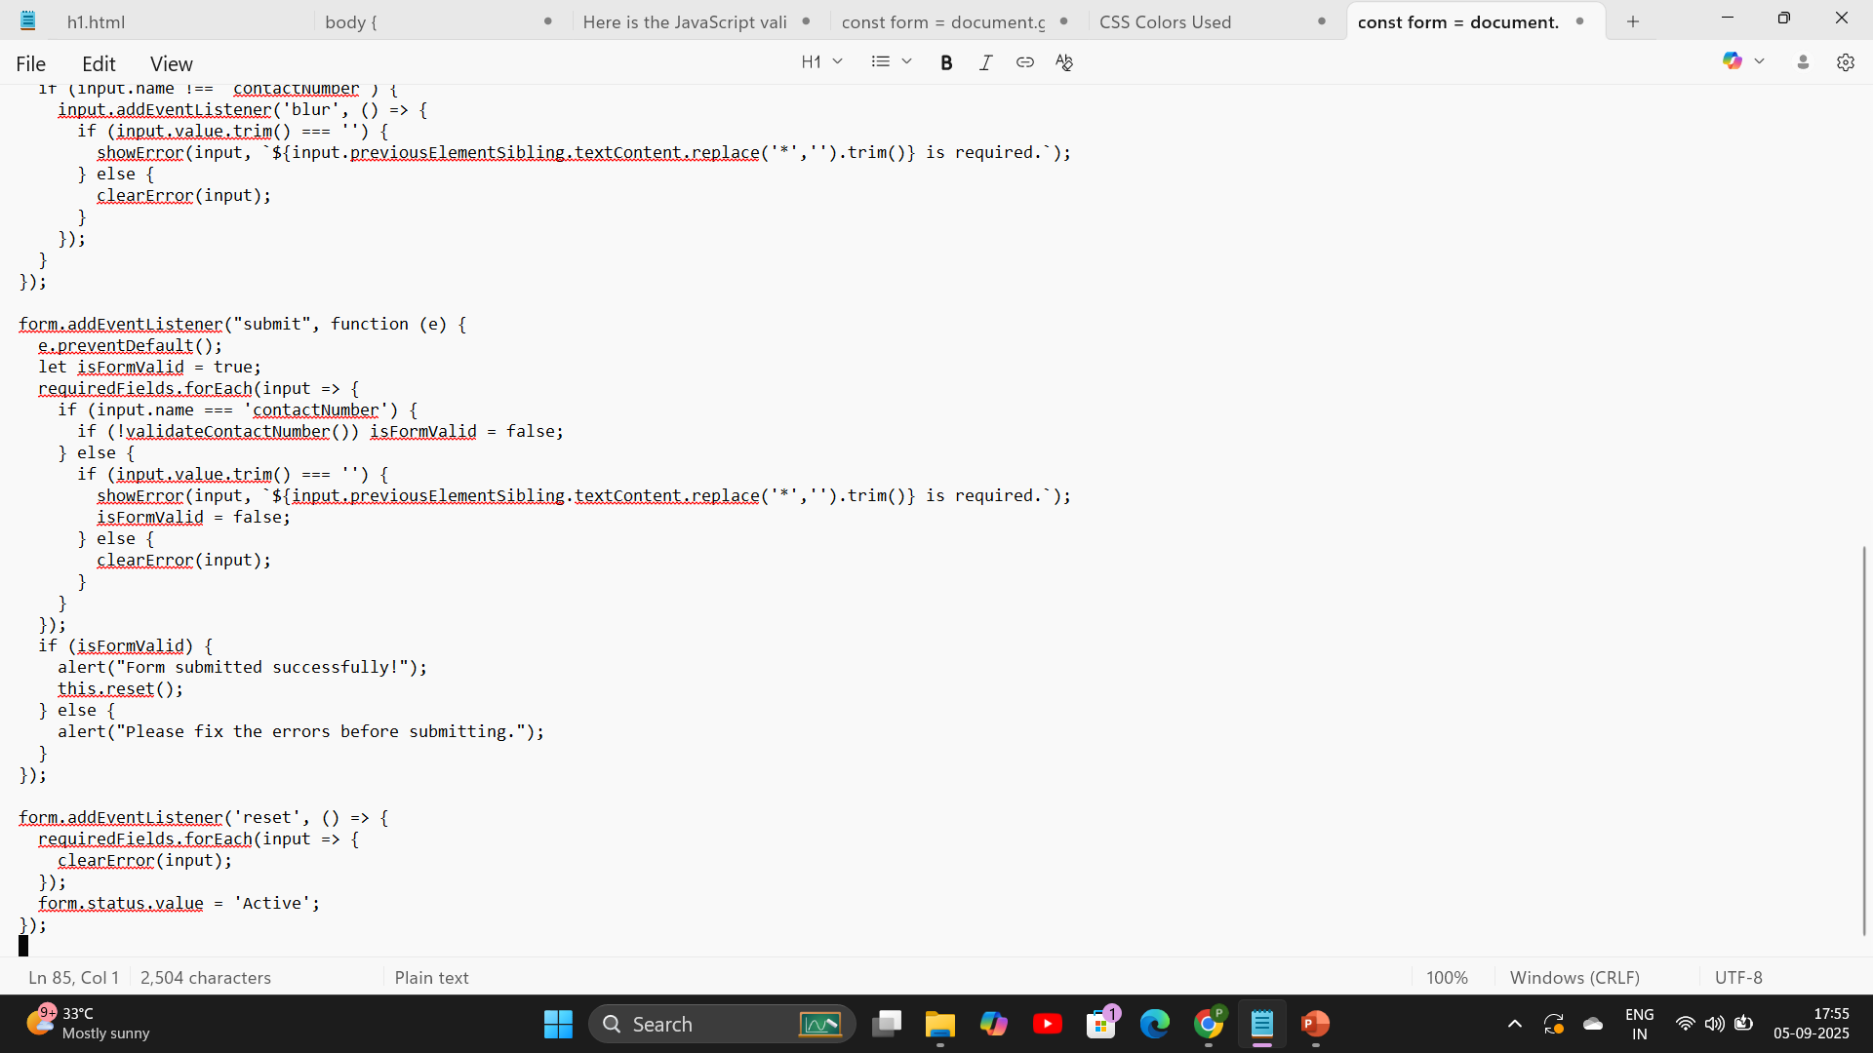
Before and After

Slide 41
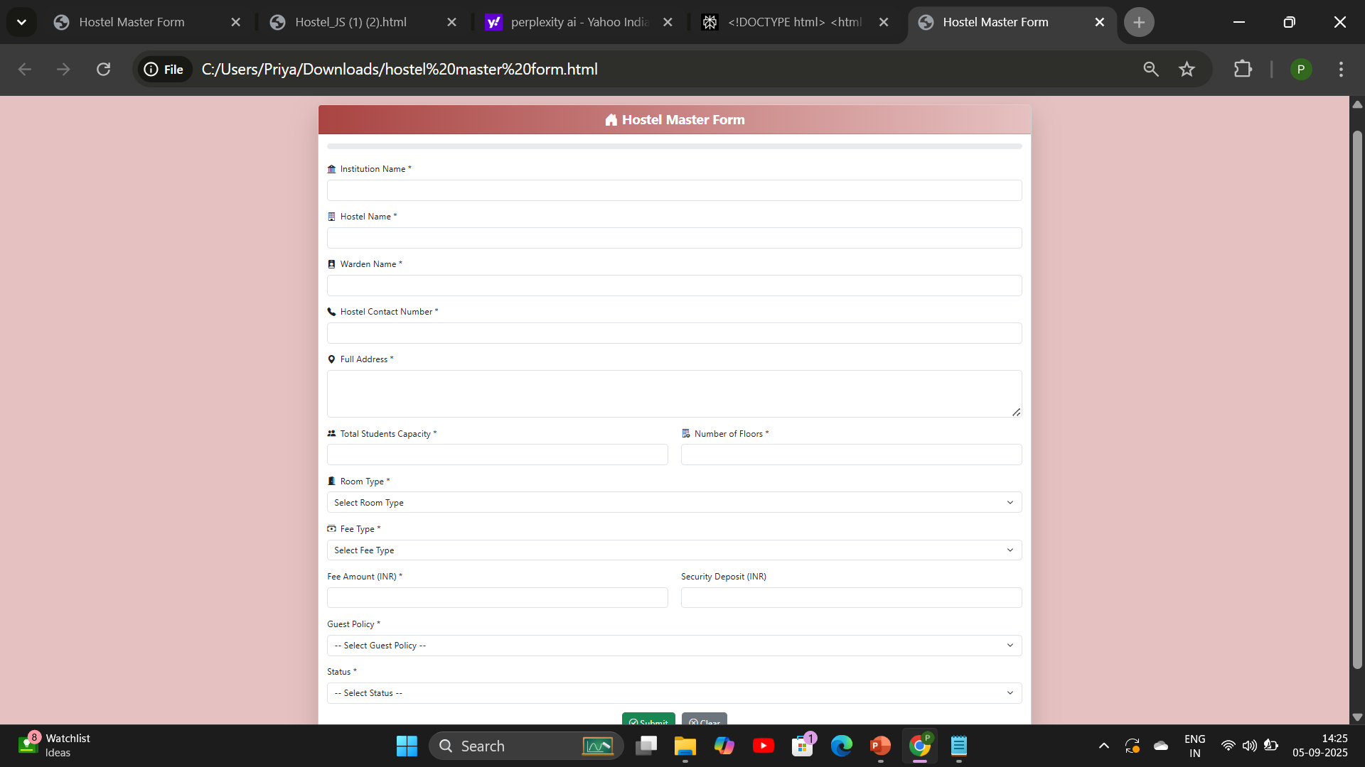
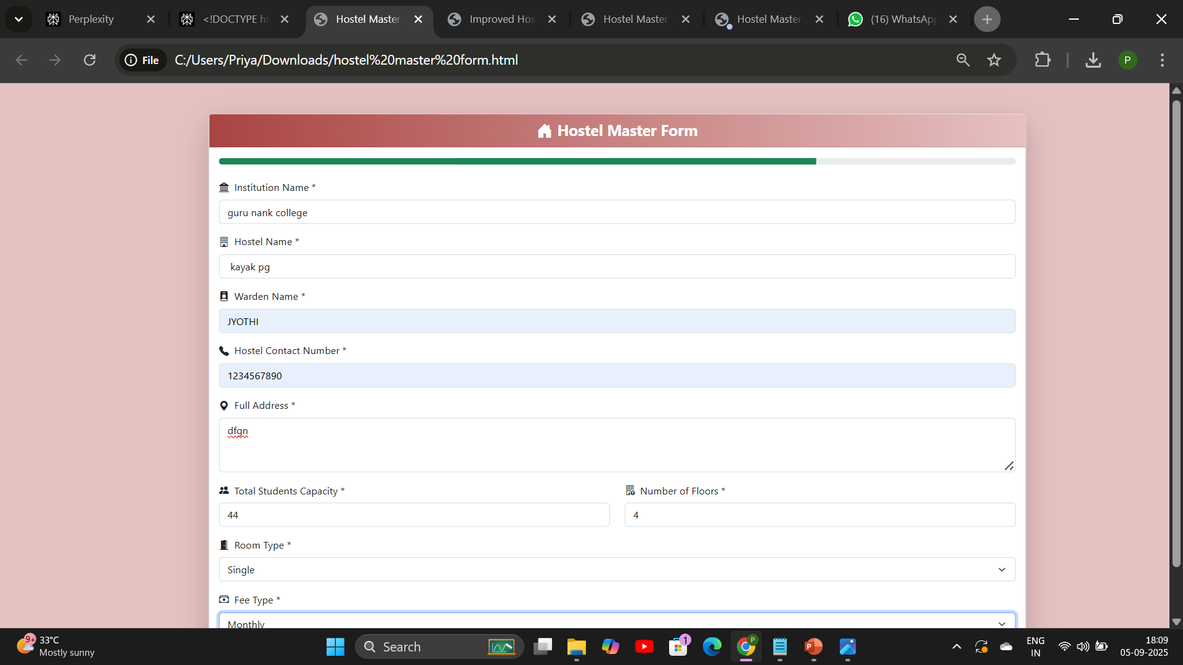
Before and After adding jquery

Slide 42
Bootstrap
Bootstrap is a popular front-end framework.
Provides ready-to-use CSS classes & components.
Helps in creating a responsive, modern, and professional design with less code.

Slide 43
Layout & Responsiveness
Used Bootstrap Grid System (row, col-md-6, etc.) for form alignment.
Ensures form is responsive across devices (desktop, tablet, mobile).
Centered form using container, row, and col-lg-8.

Slide 44
Form Styling with Bootstrap
form-control & form-select → styled inputs, dropdowns, and textarea.
invalid-feedback → built-in error messages for validation.
form-check → styled checkboxes.
fieldset & legend combined with Bootstrap classes for neat grouping.

Slide 45
Buttons & Colors
Used Bootstrap button classes (btn, btn-primary, btn-secondary).
Customized with CSS variables for brand colors.
Buttons are consistent, responsive, and have hover effects.

Slide 46
Navigation Bar
Bootstrap Navbar component used at the top.
Responsive toggle (navbar-toggler) for smaller screens.
Includes branding (logo + text) and navigation links.

Slide 47
Add the navigation bar before and after

Slide 48
Modal for Confirmation
Bootstrap Modal used for confirmation popup before clearing form.
Provides a clean UI with built-in animations and responsive behavior.
Buttons inside modal use Bootstrap styling.

Slide 49
Bootstrap in form
Bootstrap includes native support for showing validation states with classes for valid/invalid inputs, plus helpful feedback messages, improving user experience.
Customizable Components:
You can easily customize colors, sizes, and layouts by overriding Bootstrap variables or adding your own styles on top.
Cross-browser Compatibility:

Slide 50
Large Community and Documentation:
Extensive documentation and community support
Using Bootstrap classes like form-control, btn, and layout utilities saves time and effort since you don't need to write extensive custom CSS for common form styles.
Built-in Validation Styles:

Slide 51
Utility Classes
Spacing utilities (mb-4, p-3, gap-2, etc.) for consistent margins/padding.
Typography classes (fw-bold, text-primary, text-center) for readability.
Border & shadow utilities (border, shadow-sm, rounded) for a modern card-like look

Slide 52
Overall Benefits of Bootstrap
Reduced custom CSS → faster development.
Ensures consistency & responsiveness across all browsers.
Provides modern look with minimal effort.
Easily customizable with CSS overrides.

Slide 53
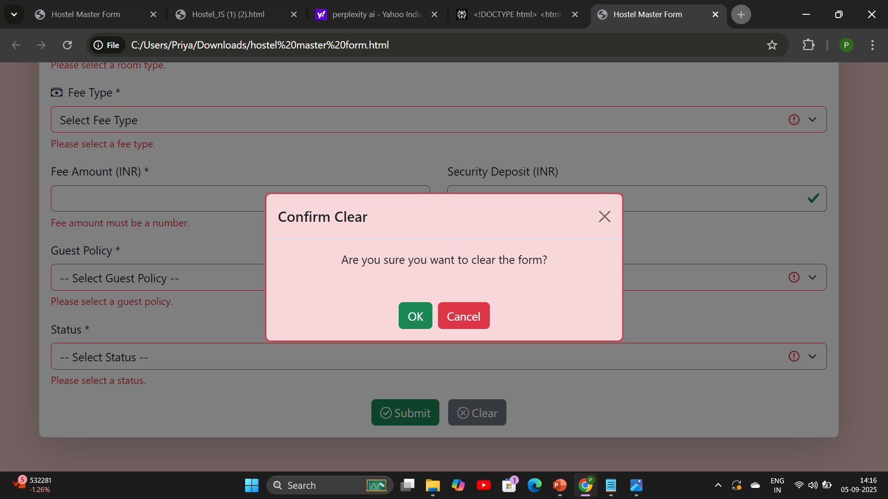
Clear pop up

Slide 54
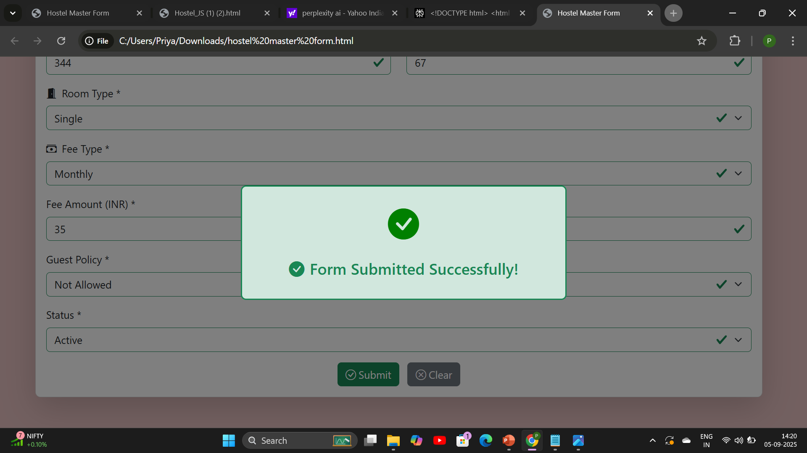
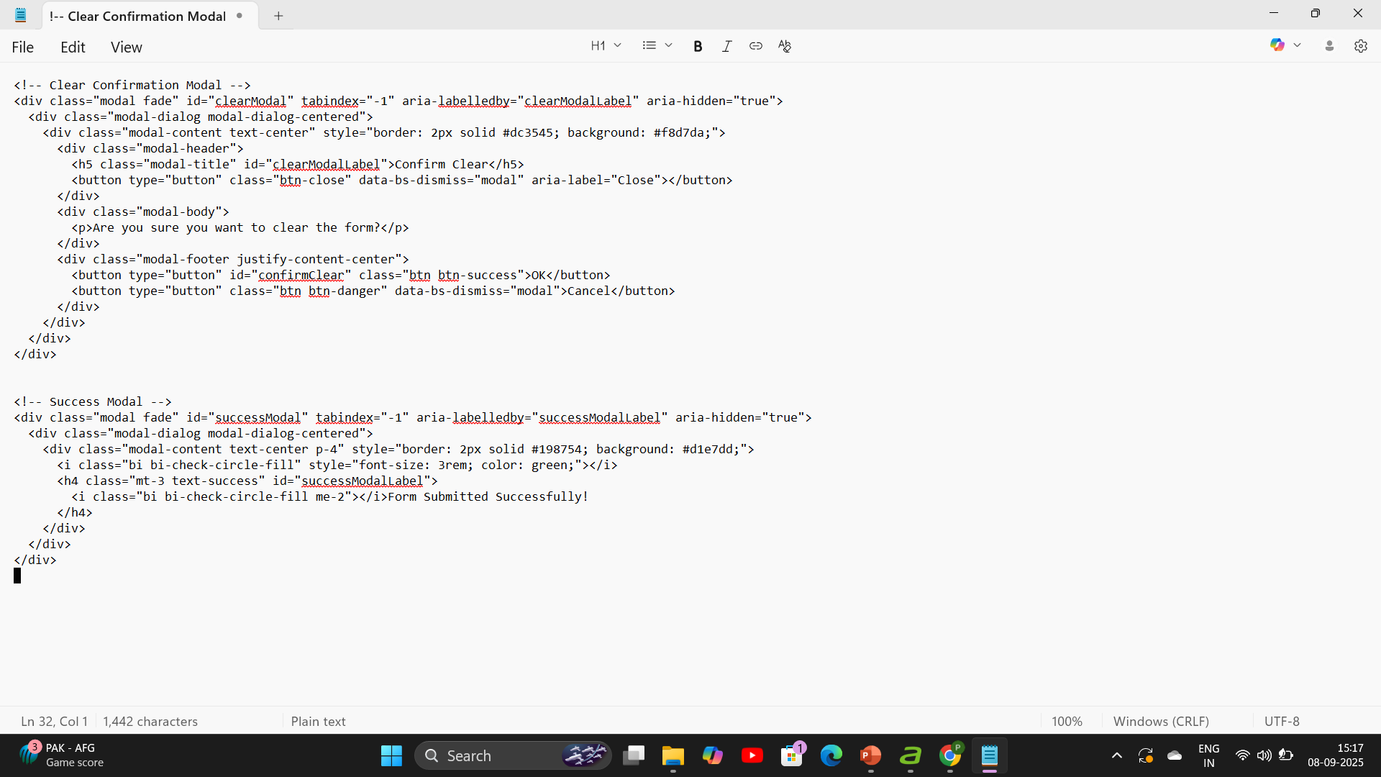
Confirmation pop up

Slide 55
Conclusion
The Customer Details Form demonstrates how different web technologies work together to build a complete, functional application.
HTML → provides the structure of the form (fields, labels, sections).
CSS → improves design, styling, and user experience.
Bootstrap → ensures responsiveness, consistency, and faster development with ready-made components.
JavaScript/jQuery → adds interactivity, validation, automation, and feedback.
By combining these, the form becomes user-friendly, dynamic, and professional, showing how front-end technologies integrate to create real-world web applications.

